Slide 1
Functions

Slide 2
Functions: Defining a Function
So far we have seen many built-in Python functions. In this section, we will focus on custom functions. What is a function? Before we start making functions, let us learn what a function is and why we need them?
A function is a reusable block of code or programming statements designed to perform a certain task. To define or declare a function, Python provides the def keyword. The following is the syntax for defining a function. The function block of code is executed only if the function is called or invoked.

Slide 3
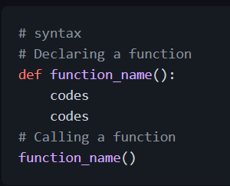
Declaring and Calling a Function
When we make a function, we call it declaring a function. When we start using the it, we call it calling or invoking a function. Function can be declared with or without parameters.

Slide 4
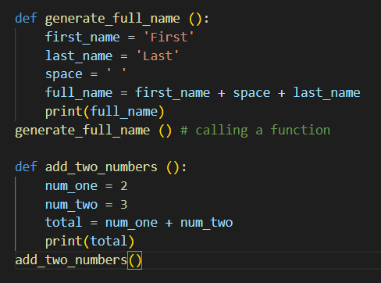
Function without Parameters
Function can be declared without parameters.

Slide 5
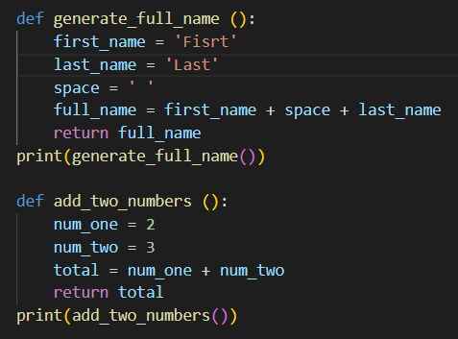
Function Returning a Value
Function can also return values, if a function does not have a return statement, the value of the function is None. Let us rewrite the above functions using return. From now on, we get a value from a function when we call the function and print it.

Slide 6
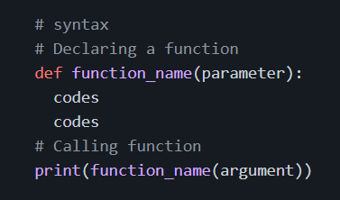
Function with Parameters
In a function we can pass different data types(number, string, boolean, list, tuple, dictionary or set) as a parameter
Single Parameter: If our function takes a parameter we should call our function with an argument

Slide 7
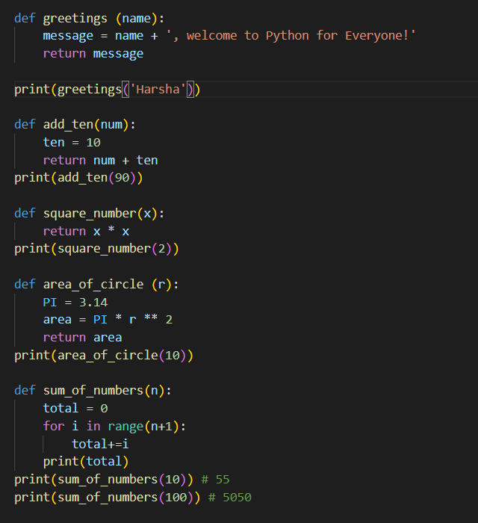

Slide 8
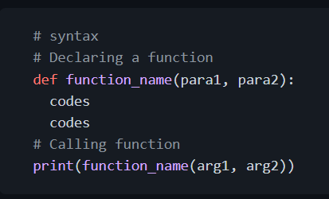
Two Parameter: A function may or may not have a parameter or parameters. A function may also have two or more parameters. If our function takes parameters we should call it with arguments. Let us check a function with two parameters:

Slide 9
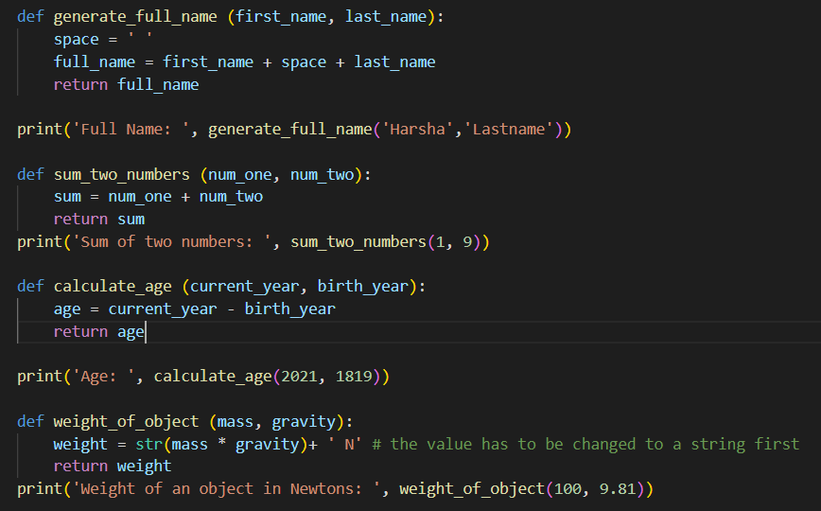

Slide 10
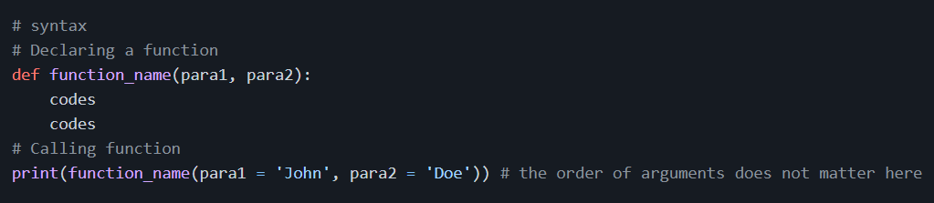
Passing Arguments with Key and Value
If we pass the arguments with key and value, the order of the arguments does not matter.

Slide 11
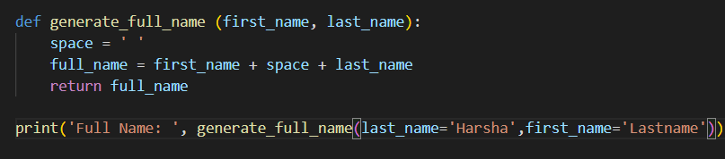
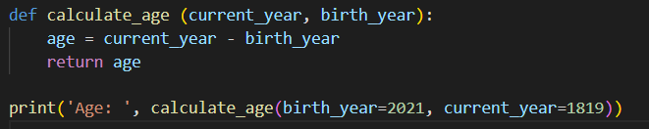

Slide 12
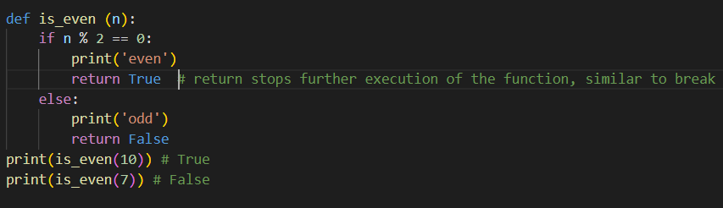
Returning a boolean: Example:

Slide 13
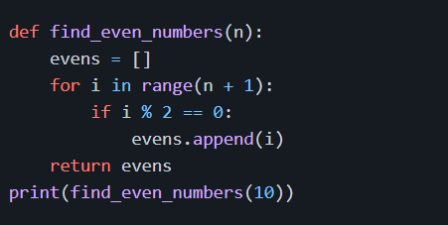
Returning a list: Example:

Slide 14
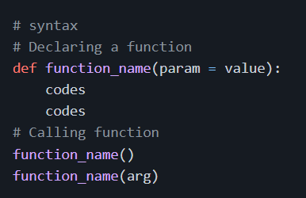
Function with Default Parameters
Sometimes we pass default values to parameters, when we invoke the function. If we do not pass arguments when calling the function, their default values will be used.

Slide 15
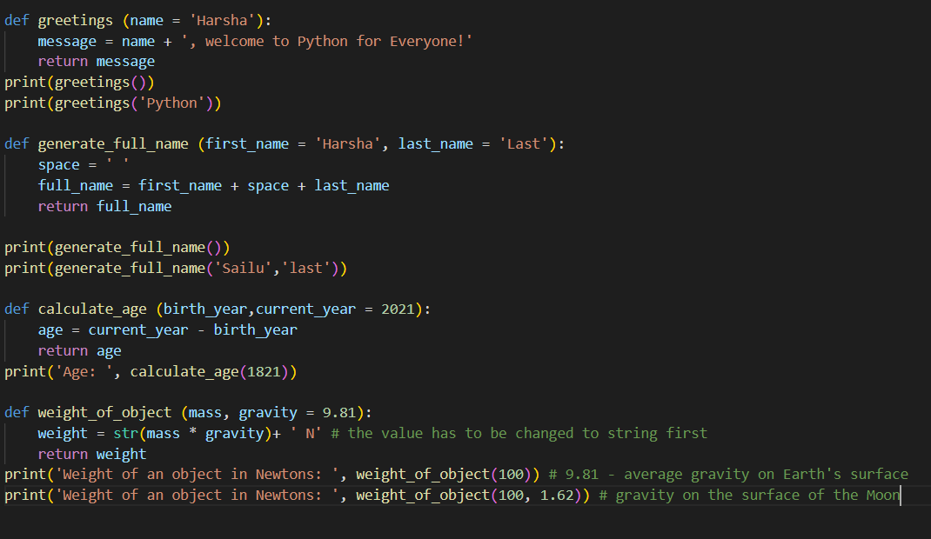

Slide 16
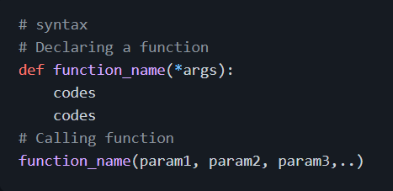
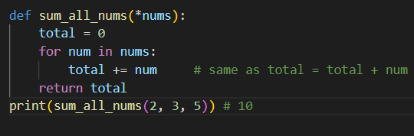
Arbitrary Number of Arguments
If we do not know the number of arguments we pass to our function, we can create a function which can take arbitrary number of arguments by adding * before the parameter name.

Slide 17
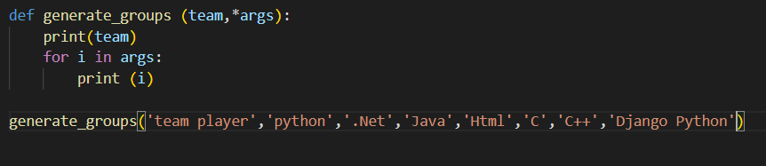
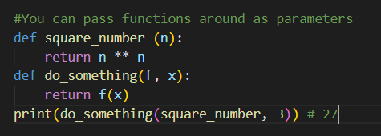
Default and Arbitrary Number of Parameters in Functions
Function as a Parameter of Another Function

Slide 18
💻 Exercises: Day 11
Exercises: Level 1
Declare a function add_two_numbers. It takes two parameters and it returns a sum.
Area of a circle is calculated as follows: area = π x r x r. Write a function that calculates area_of_circle.
Write a function called add_all_nums which takes arbitrary number of arguments and sums all the arguments. Check if all the list items are number types. If not do give a reasonable feedback.
Temperature in °C can be converted to °F using this formula: °F = (°C x 9/5) + 32. Write a function which converts °C to °F, convert_celsius_to-fahrenheit.
Write a function called check-season, it takes a month parameter and returns the season: Autumn, Winter, Spring or Summer.
Write a function called calculate_slope which return the slope of a linear equation

Slide 19
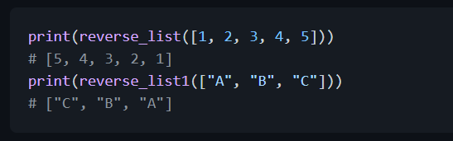
Quadratic equation is calculated as follows: ax² + bx + c = 0. Write a function which calculates solution set of a quadratic equation, solve_quadratic_eqn.
Declare a function named print_list. It takes a list as a parameter and it prints out each element of the list.
Declare a function named reverse_list. It takes an array as a parameter and it returns the reverse of the array (use loops).
Declare a function named capitalize_list_items. It takes a list as a parameter and it returns a capitalized list of items

Slide 20
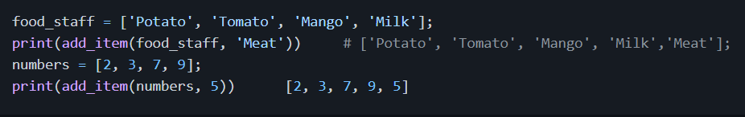
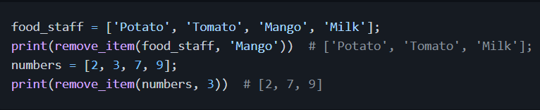
Declare a function named add_item. It takes a list and an item parameters. It returns a list with the item added at the end.
Declare a function named remove_item. It takes a list and an item parameters. It returns a list with the item removed from it.

Slide 21
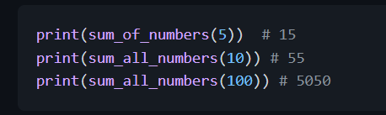
Declare a function named sum_of_numbers. It takes a number parameter and it adds all the numbers in that range.
Declare a function named sum_of_odds. It takes a number parameter and it adds all the odd numbers in that range.
Declare a function named sum_of_even. It takes a number parameter and it adds all the even numbers in that - range.

Slide 22
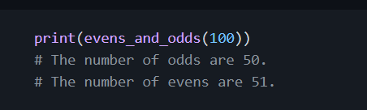
Exercises: Level 2
Declare a function named evens_and_odds . It takes a positive integer as parameter and it counts number of evens and odds in the number.
Call your function factorial, it takes a whole number as a parameter and it return a factorial of the number
Call your function is_empty, it takes a parameter and it checks if it is empty or not
Write different functions which take lists. They should calculate_mean, calculate_median, calculate_mode, calculate_range, calculate_variance, calculate_std (standard deviation).

Slide 23
Exercises: Level 3
Write a function called is_prime, which checks if a number is prime.
Write a functions which checks if all items are unique in the list.
Write a function which checks if all the items of the list are of the same data type.
Write a function which check if provided variable is a valid python variable
Go to the data folder and access the countries-data.py file.
Create a function called the most_spoken_languages in the world. It should return 10 or 20 most spoken languages in the world in descending order
Create a function called the most_populated_countries. It should return 10 or 20 most populated countries in descending order.

